Slide 1
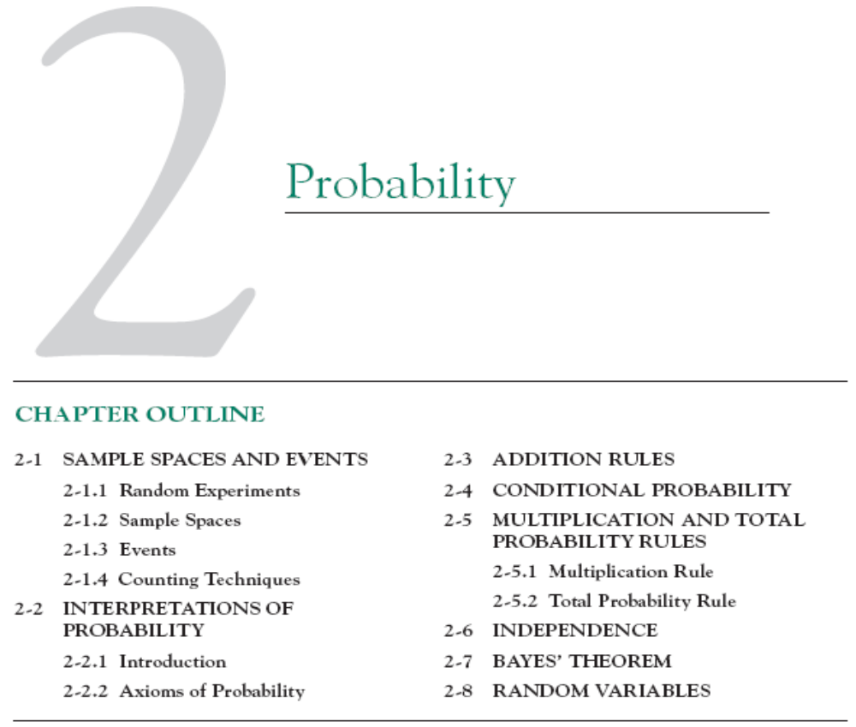

Slide 2
2-2 Interpretations of Probability
2-2.1 Introduction
Probability
Used to quantify likelihood or chance
Used to represent risk or uncertainty in engineering applications
Can be interpreted as our degree of belief or relative frequency

Slide 3
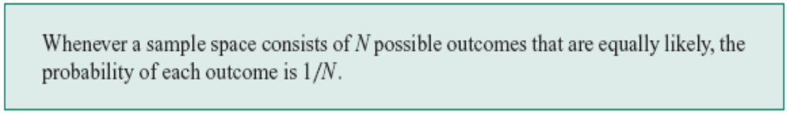
2-2 Interpretations of Probability
Equally Likely Outcomes

Slide 4

2-2 Interpretations of Probability
Definition

Slide 5
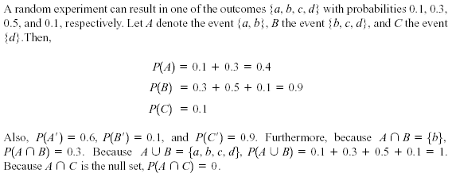
2-2 Interpretations of Probability
Example 2-16

Slide 6
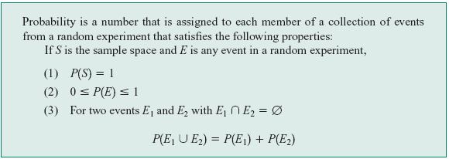
2-2 Interpretations of Probability
2-2.2 Axioms of Probability

Slide 7
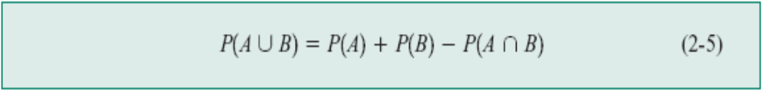
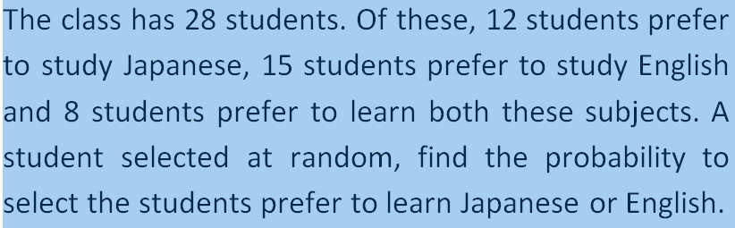
2-3 Addition Rules
Probability of a Union
Example

Slide 8
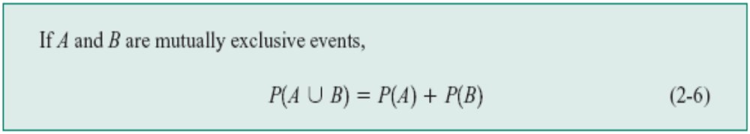
2-3 Addition Rules
Mutually Exclusive Events

Slide 9
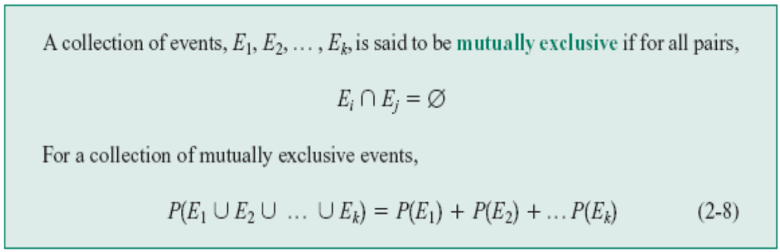
2-3 Addition Rules

Slide 10
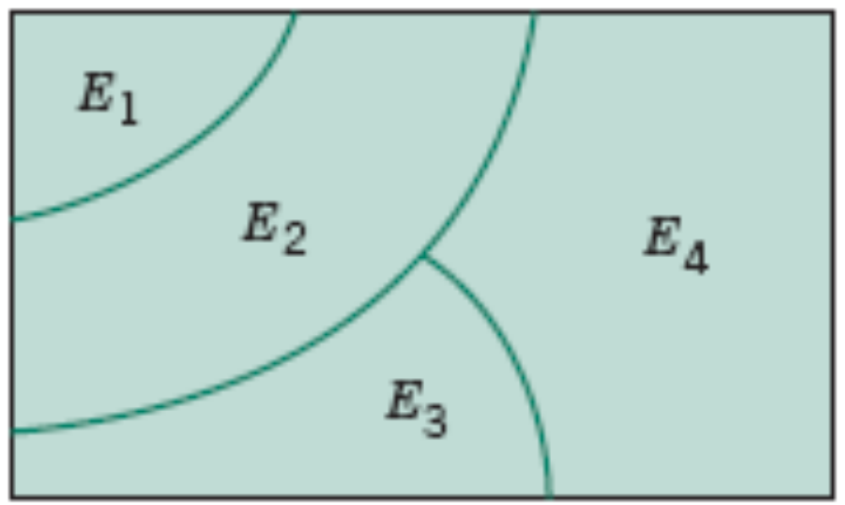
2-3 Addition Rules
Figure 2-12 Venn diagram of four mutually exclusive events

Slide 11
2-4 Conditional Probability
To introduce conditional probability, consider an example involving manufactured parts.
Let D denote the event that a part is defective and let F denote the event that a part has a surface flaw.
Then, we denote the probability of D given, or assuming, that a part has a surface flaw as P(D|F). This notation is read as the conditional probability of D given F, and it is interpreted as the probability that a part is defective, given that the part has a surface flaw.
Notes:
Flaw: vết rạn

Slide 12
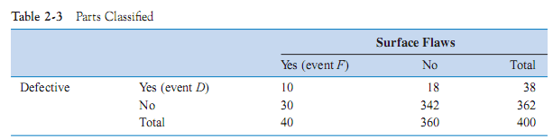
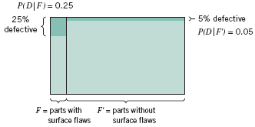
2-4 Conditional Probability
Figure 2-13 Conditional probabilities for parts with surface flaws

Slide 13
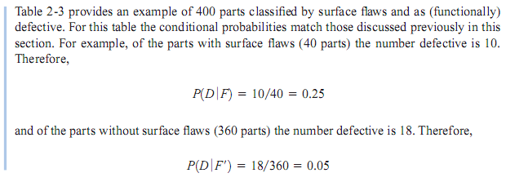
2-4 Conditional Probability
28
D ngang
F dọc
372

Slide 14
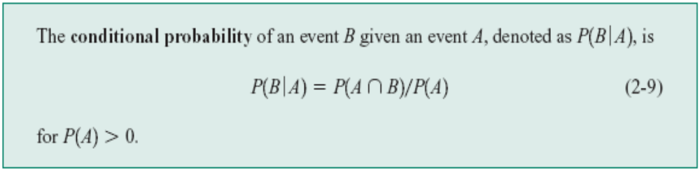
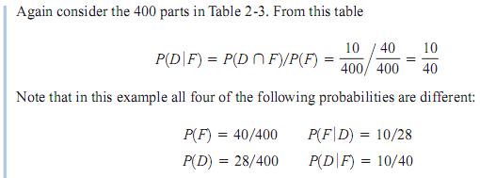
2-4 Conditional Probability
Definition

Slide 15
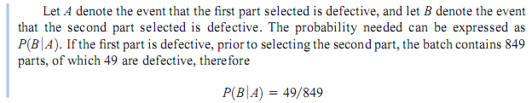
2-4 Conditional Probability

Slide 16
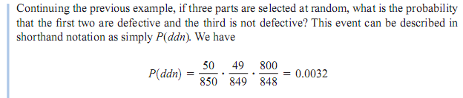
2-4 Conditional Probability

Slide 17
2-5. Multiplication and Total Probability Rules
2-5.1 Multiplication Rule

Slide 18
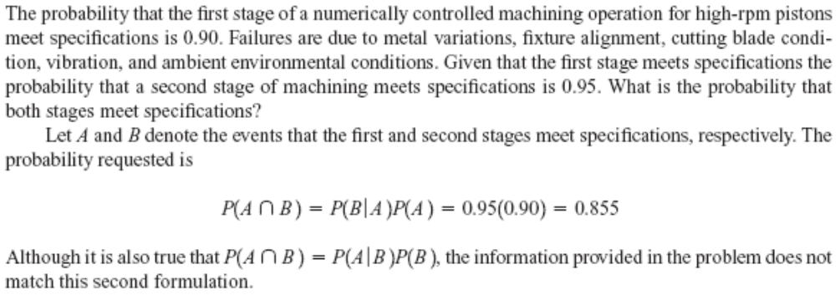
2-5 Multiplication and Total Probability Rules
Example 2-26
Notes:
Machining: su gia cong co khi; blade:luoi dao; vibration: su dao donng; ambient: bao quanh;

Slide 19
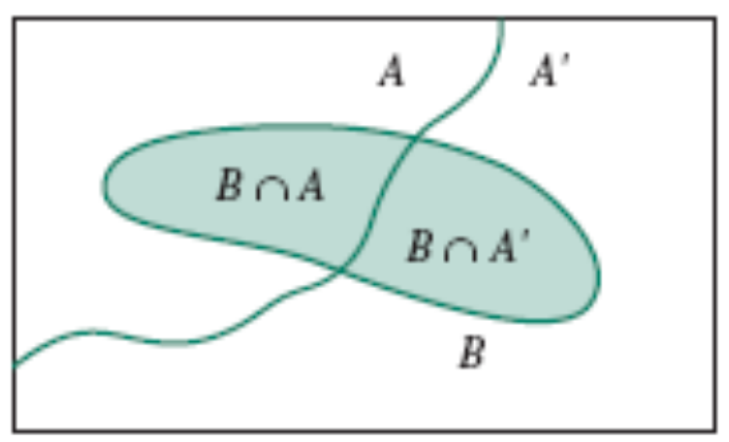
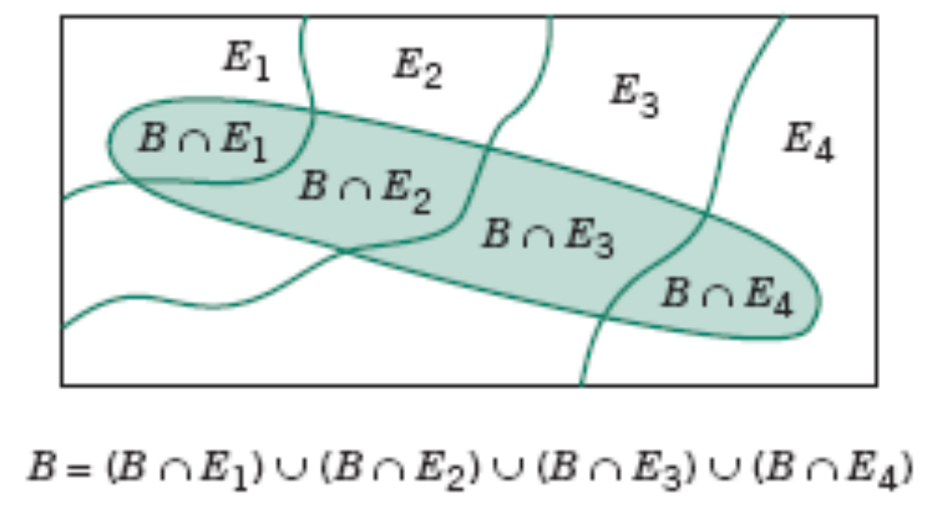
2-5 Multiplication and Total Probability Rules
2-5.2 Total Probability Rule
Figure 2-15 Partitioning an event into two mutually exclusive subsets.
Figure 2-16 Partitioning an event into several mutually exclusive subsets.
Notes:
Subject: bat phai chiu

Slide 20
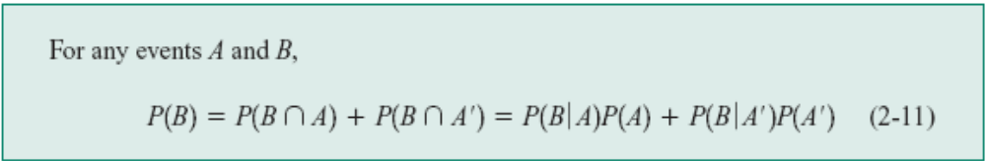
2-5 Multiplication and Total Probability Rules
2-5.2 Total Probability Rule (two events)

Slide 21
2-5 Multiplication and Total Probability Rules
Example 2-27
Suppose that in semiconductor manufacturing the probability is 0.10 that a chip that is subjected to high levels of contamination during manufacturing causes a product failure. The probability is 0.005 that a chip that is not subjected to high contamination levels during manufacturing causes a product failure. In a particular production run, 20% of the chip are subject to high levels of contamination. What is the probability that a product using one of these chips fails?
Clearly, the requested probability depends on whether or not the chip was exposed to high levels of contamination.
Notes:
Contamination: su lam bẩn

Slide 22
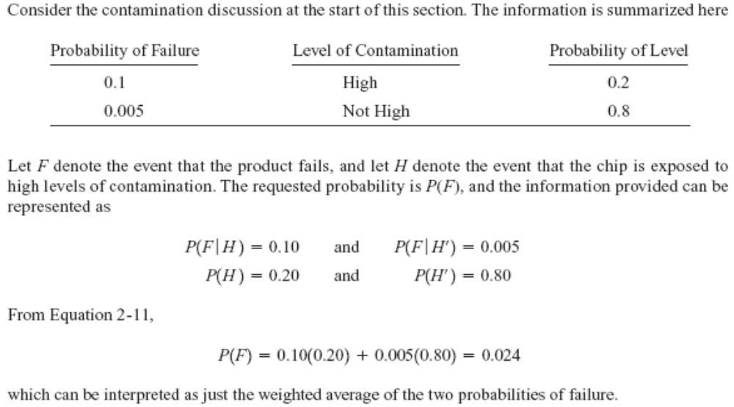
2-5 Multiplication and Total Probability Rules
Example 2-27
Notes:
Contamination: su lam bẩn

Slide 23
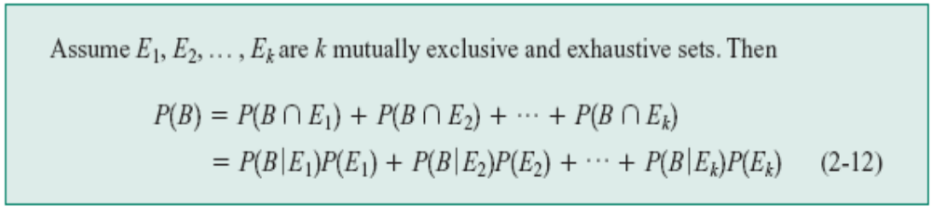
2-5 Multiplication and Total Probability Rules
Total Probability Rule (multiple events)

Slide 24

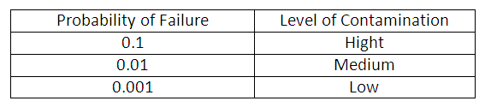
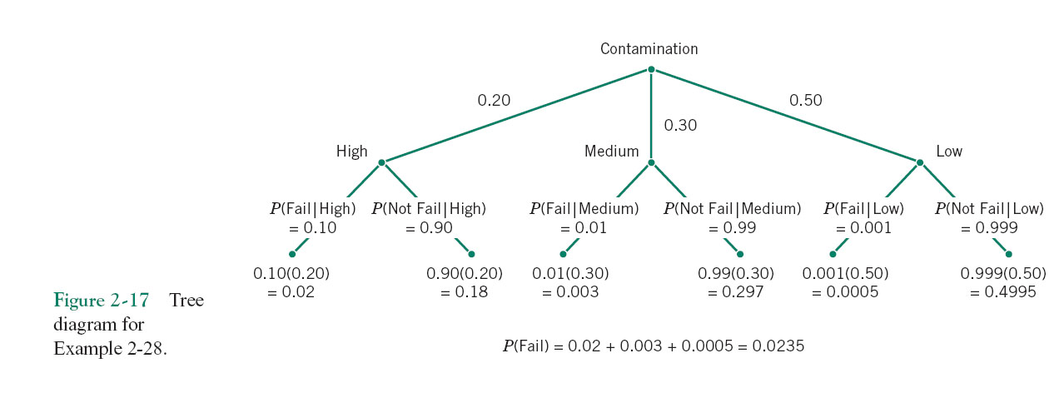
2-5 Multiplication and Total Probability Rules
Notes:
89, 90,92, 94,96,116,120

Slide 25

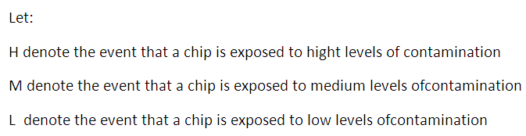
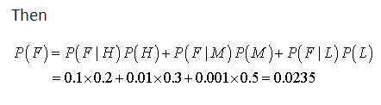
2-5 Multiplication and Total Probability Rules

Slide 26
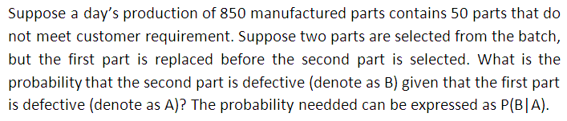

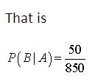
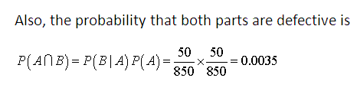
2-6. Independence

Slide 27
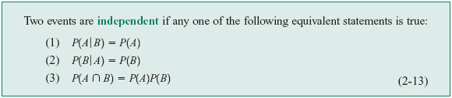
2-6. Independence
Definition (two events)

Slide 28

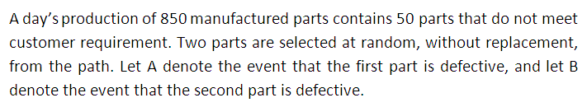

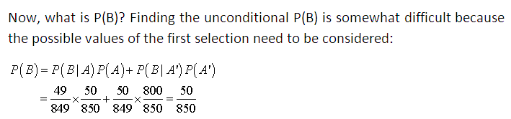
2-6. Independence

Slide 29
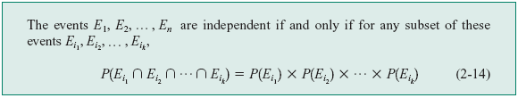
2-6. Independence
Definition (multiple events)

Slide 30

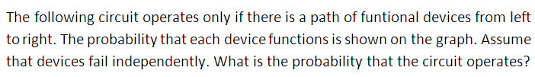

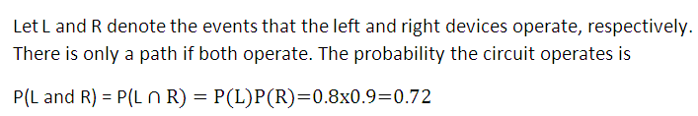
2-6. Independence

Slide 31

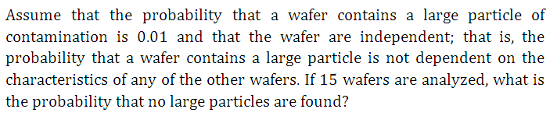
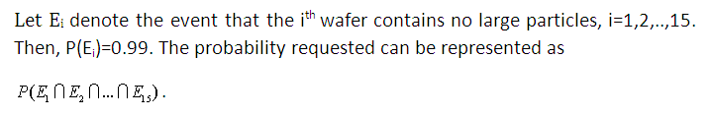

2-6. Independence

Slide 32
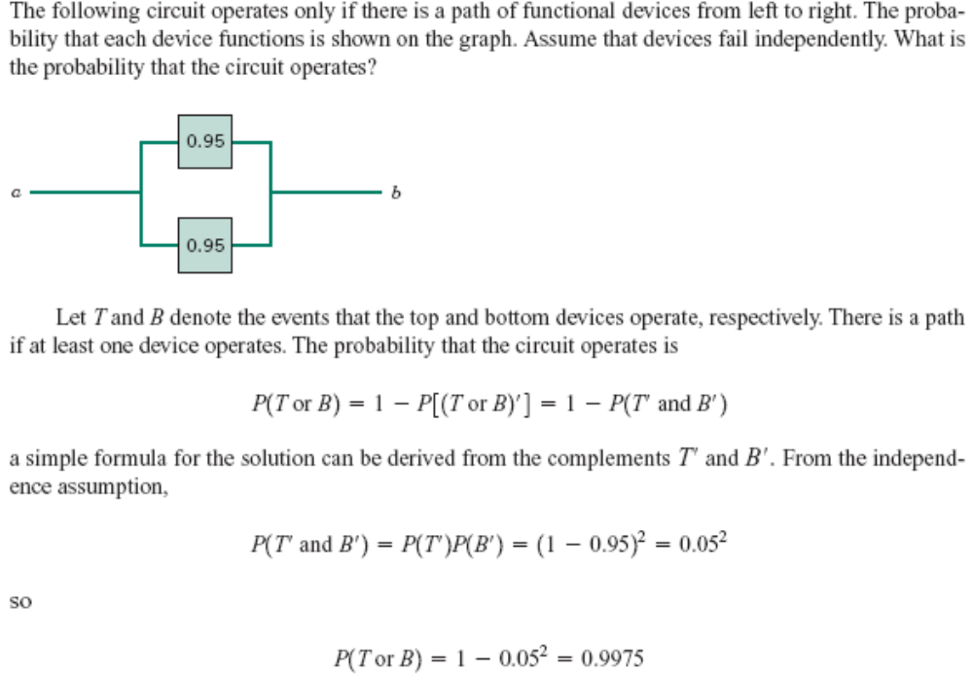
2-6. Independence
Example 2-34

Slide 33


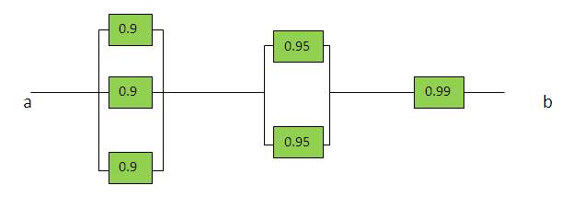
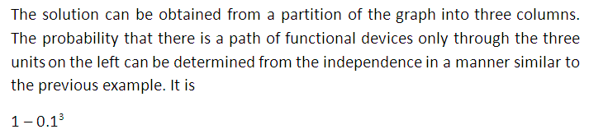
2-6. Independence

Slide 34
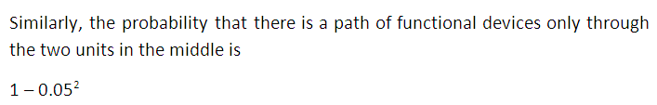
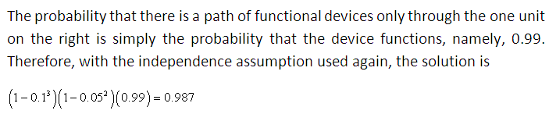
2-6. Independence

Slide 35
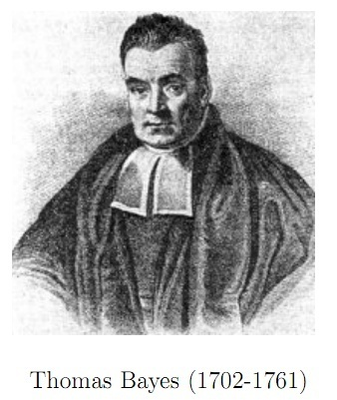

2-7 Bayes’ Theorem
Definition

Slide 36
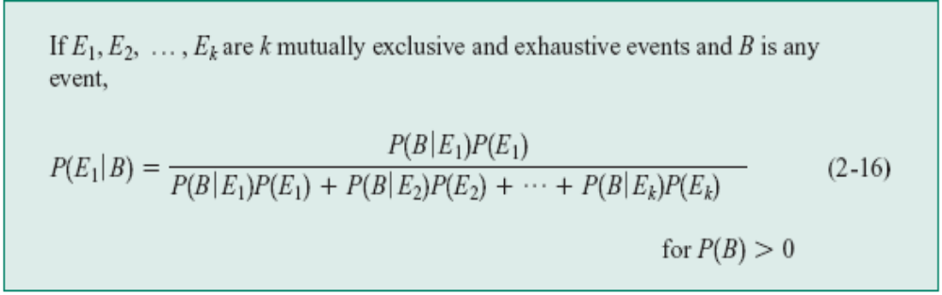
2-7 Bayes’ Theorem
Bayes’ Theorem

Slide 37
Example 2-38
Bayesian networks are used on the Web sites of hight – technology manufactures to allow customers to quickly diagnose problems with products. An oversimplified example is presented here. A printer manufacturer obtained the following probabilities from a database of test results. Printer failures are associated with three types of problems: hardware, software and other (such as connectors), with probabilities 0.1, 0.6, and 0.3, respectively. The probability of a printer failure given a hardware problem is 0.9, given software problem is 0.2 and given any other type of problem is 0.5. If a customer enters the manufacturer’s Web site to diagnose, what is the most likely cause of the problem?
Notes:
Diagnose: chuan doan

Slide 38
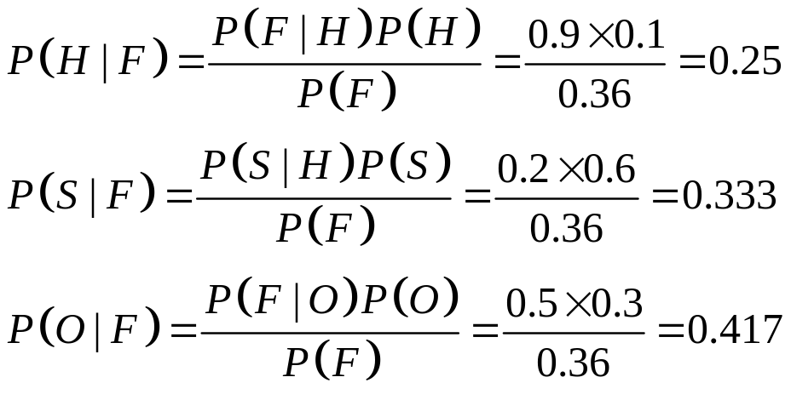
Let the events H, S and O denote a hardware, software and other problem, respectively and let F denote a printer failure. The most likely cause of the problem is the one that corresponds to the largest of P(H/F), P(S|F) and P(O|F). In Bayes’Theorem the denominatior is
Then

Slide 39
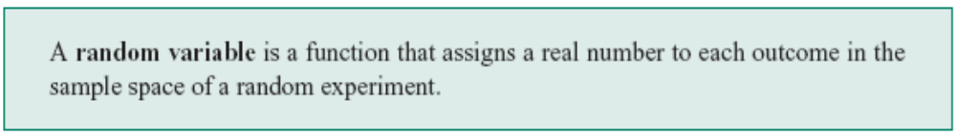
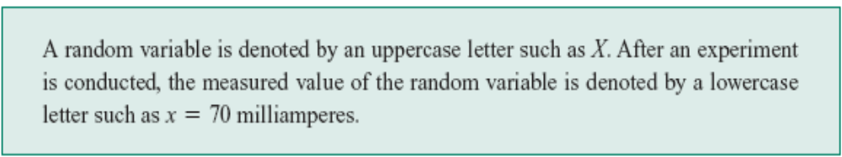
2-8. Random Variables
Definition

Slide 40
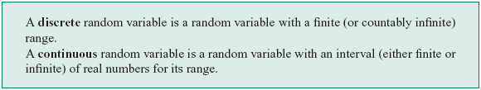
2-8. Random Variables
Definition

Slide 41
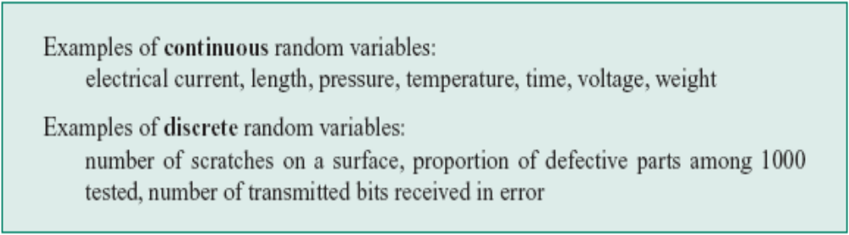
2-8. Random Variables
Examples of Random Variables

Slide 42
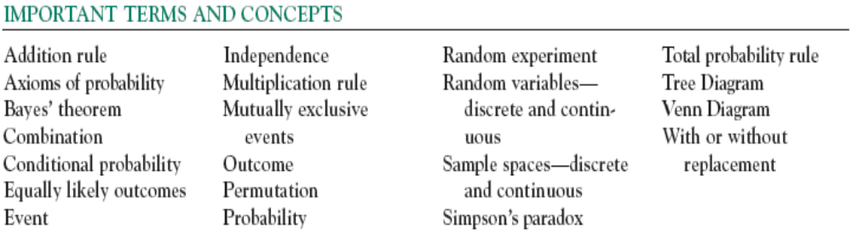

Slide 43

THANKS!

Slide 44



